Slide 1
Data Structures
&
Algorithms

Slide 2

Function & Recursion

Slide 3
1. Function
2. The Concept Of Stack
3. The Sequence Of Execution During A Function Call
4. Parameter Passing & Call By Reference
5. Resolving Variable References
6. Recursion
7. Stack Overheads In Recursion
8. Writing A Recursive Function
9. Types Of Recursion

Slide 4
1. FUNCTION
Provide modularity to the software
Divide complex tasks into small Manageable tasks
Avoid duplication of work

Slide 5
int sumOfArray(int M[] , int n)
{
int nSum=0;
for(int i=0;i<n;i++)
{
nSum=nSum+M[i];
}
return nSum;
}

Slide 6
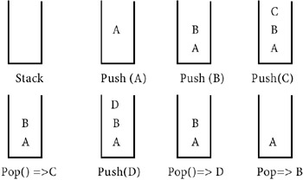
2. THE CONCEPT OF STACK
A stack is memory in which values are stored and retrieved in "last in first out" manner by using operations called push and pop.

Slide 7
3. THE SEQUENCE OF EXECUTION DURING A FUNCTION CALL
When the function is called, the current execution is temporarily stopped and the control goes to the called function. After the call, the execution resumes from the point at which the execution is stopped.
To get the exact point at which execution is resumed, the address of the next instruction is stored in the stack. When the function call completes, the address at the top of the stack is taken.

Slide 8
3. THE SEQUENCE OF EXECUTION DURING A FUNCTION CALL
Functions or sub-programs are implemented using a stack.
When a function is called, the address of the next instruction is pushed into the stack.
When the function is finished, the address for execution is taken by using the pop operation.

Slide 9
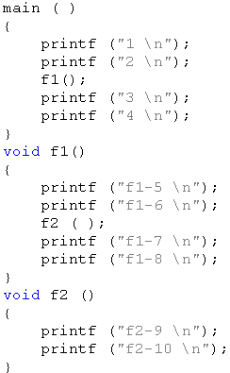

Slide 10
4. PARAMETER * REFERENCE PASSING
passing by value
the value before and after the call remains the same
passing by reference
changed value after the function completes

Slide 11
N=8
(Method)
N=5
N=5
Passing by value
N=8
(Method)
N=8
N=5
Passing by reference

Slide 12
void func1(int &n)
{
n=n+10;
}
void func2(int *n)
{
*n=*n+10;
}
void func3(int n)
{
n=n+10;
}
By Value ???
By Reference???

Slide 13
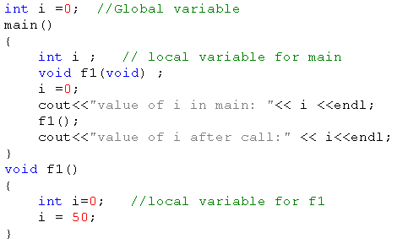
5. RESOLVING VARIABLE REFERENCES
- When a variable can be resolved by using multiple references, the local definition is given more preference

Slide 14
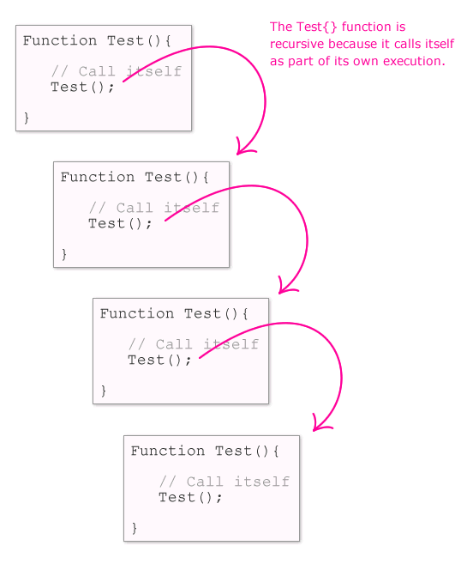
6. RECURSION
- A method of programming whereby a function directly or indirectly calls itself
- Problems: stop recursion?

Slide 15
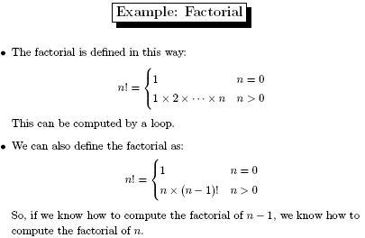
6. RECURSION

Slide 16
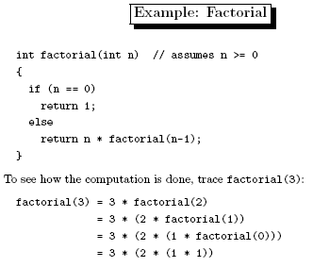
6. RECURSION

Slide 17
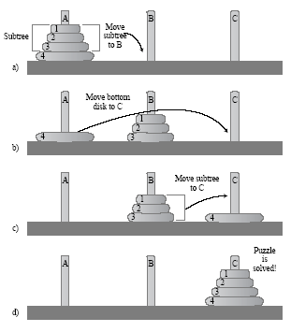
6. RECURSION
Hanoi tower

Slide 18
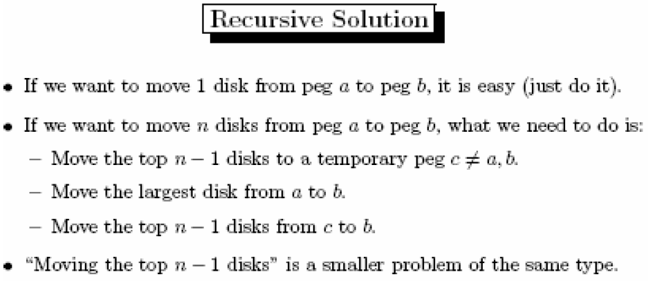
6. RECURSION

Slide 19
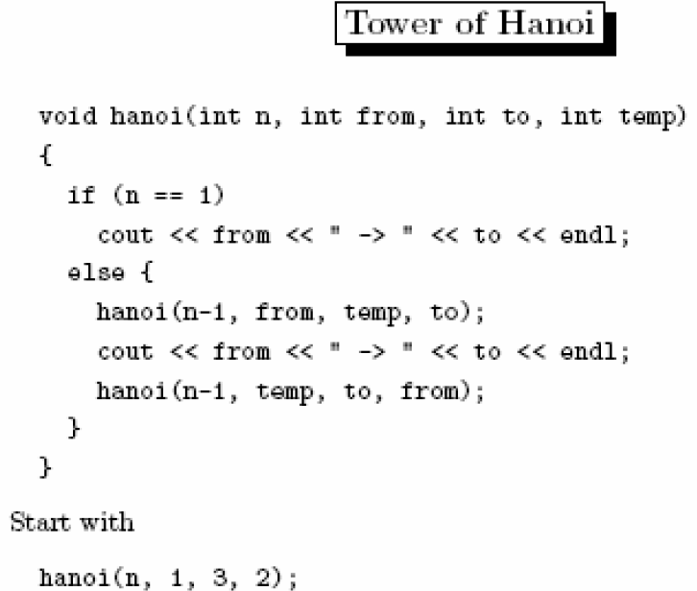
6. RECURSION

Slide 20
7. STACK OVERHEADS IN RECURSION
Two important results: the depth of recursion and the stack overheads in recursion

Slide 21
8. WRITING A RECURSIVE FUNCTION
Recursion enables us to write a program in a natural way. The speed of a recursive program is slower because of stack overheads.
In a recursive program you have to specify recursive conditions, terminating conditions, and recursive expressions.

Slide 22
9. TYPES OF RECURSION
LINEAR RECURSION (tuyến tính)
TAIL RECURSION (đuôi)
BINARY RECURSION (nhị phân)
EXPONENTIAL RECURSION (đa tuyến)
NESTED RECURSION (lồng)
MUTUAL RECURSION (tương hỗ)

Slide 23
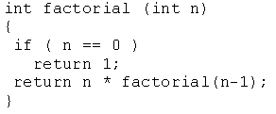
9. TYPES OF RECURSION
LINEAR RECURSION
Only makes a single call to itself each time the function runs

Slide 24
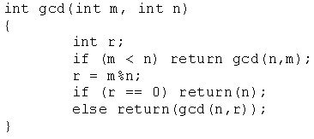
9. TYPES OF RECURSION
TAIL RECURSION
. Tail recursion is a form of linear recursion.
. In tail recursion, the recursive call is the last thing the function does. Often, the value of the recursive call is returned.

Slide 25
9. TYPES OF RECURSION
- EXPONENTIAL RECURSION
. An exponential recursive function is one that, if you were to draw out a representation of all the function calls, would have an exponential number of calls in relation to the size of the data set (exponential meaning if there were n elements, there would be O(a^{n}) function calls where a is a positive number)

Slide 26
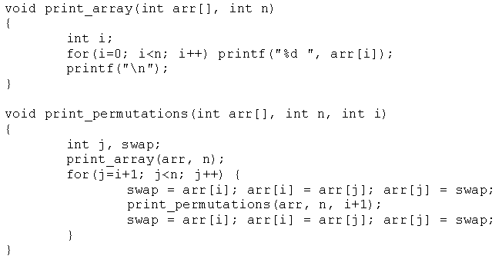
9. TYPES OF RECURSION
- EXPONENTIAL RECURSION

Slide 27
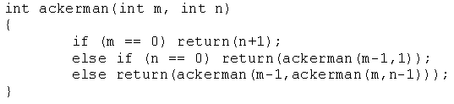
9. TYPES OF RECURSION
NESTED RECURSION
In nested recursion, one of the arguments to the recursive function is the recursive function itself
These functions tend to grow extremely fast.

Slide 28
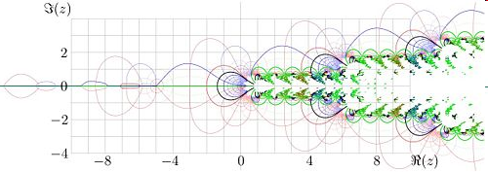

Slide 29
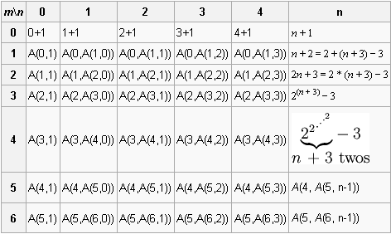

Slide 30
9. TYPES OF RECURSION
MUTUAL RECURSION
A recursive function doesn't necessarily need to call itself.
Some recursive functions work in pairs or even larger groups. For example, function A calls function B which calls function C which in turn calls function A.

Slide 31
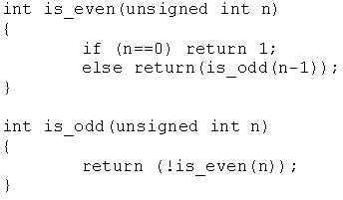
9. TYPES OF RECURSION
MUTUAL RECURSION.

Slide 32
Exercises 1: Recursion
Convert number from H10->H2
7
2
1
3
2
1
1
2
1
0

Slide 33
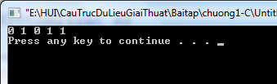
void H10toH2(int n)
{
int t=n%2;
if(n>0)
H10toH2(n/2);
cout<<t<<" ";
}
void main()
{
H10toH2(11);
}
How to run by hand???

Slide 34
Exercises 2: Recursion
E1. (43/174) Write a program to compute: S = 1 + 2 + 3 + …n using recursion.
E2 → E9 (page 43 -44 / 174)
All Student must complete E1->E9 exercises
IF not complete…

Slide 35


END

